Slide 1
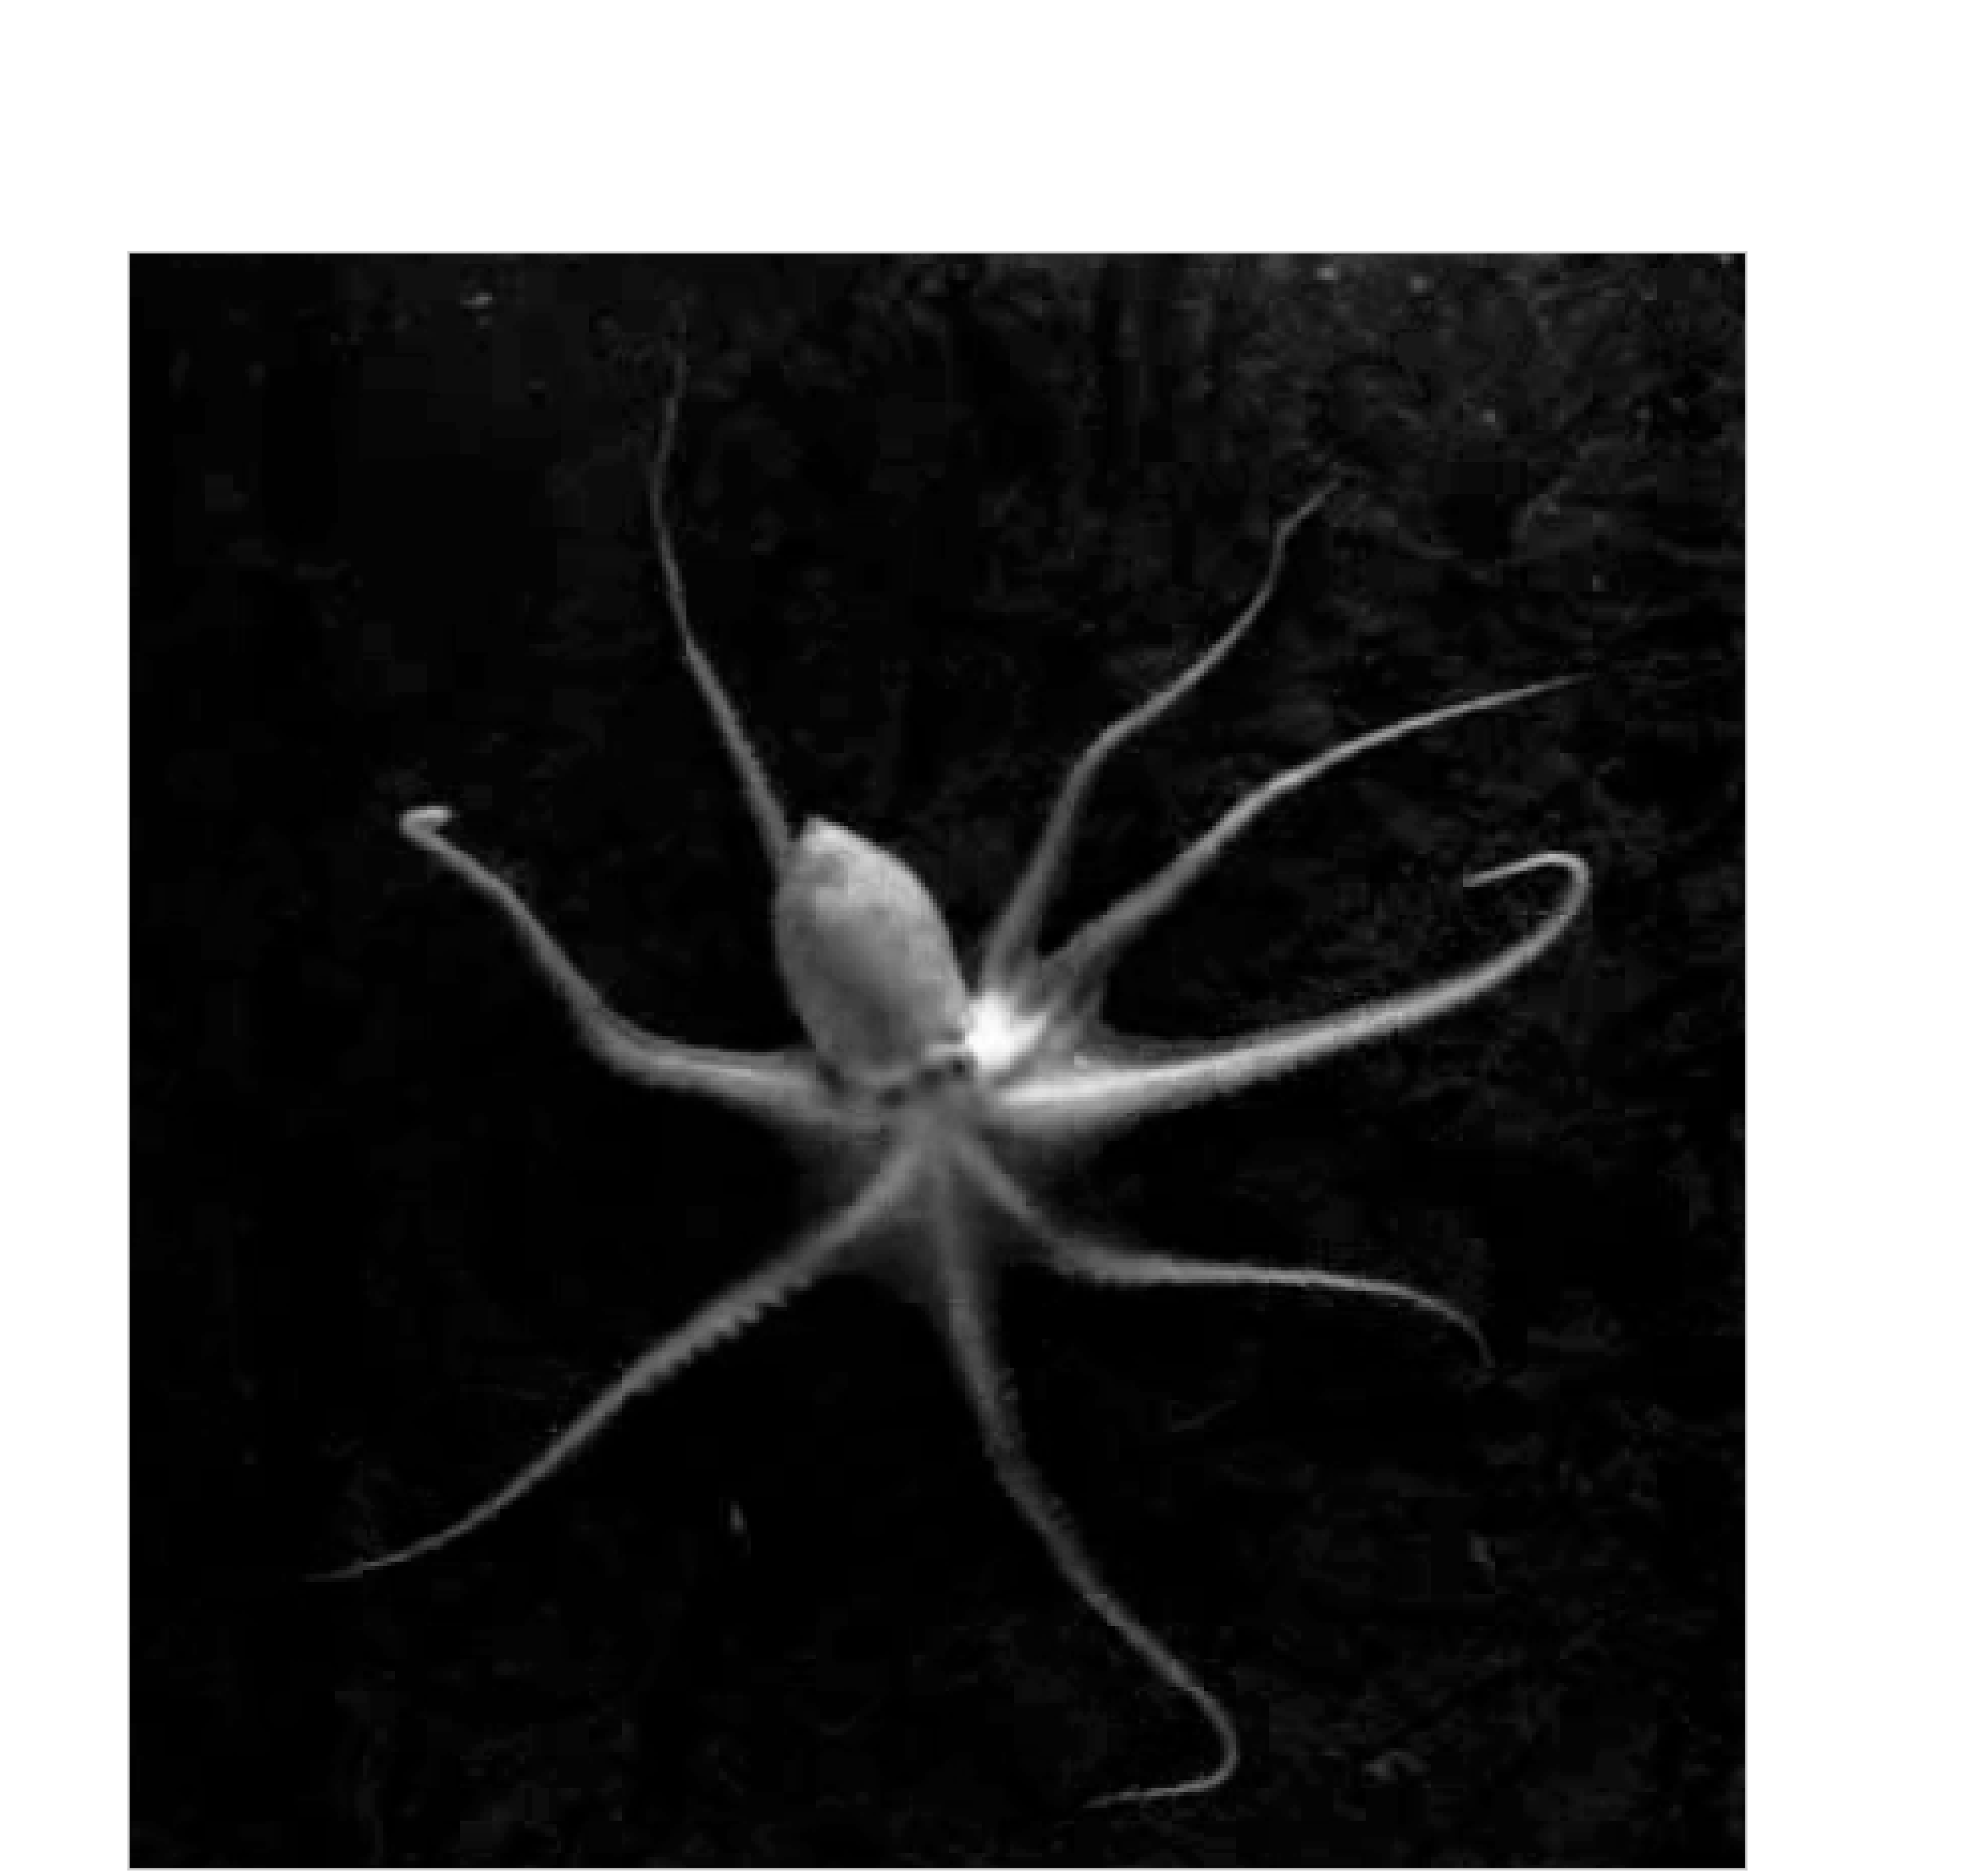
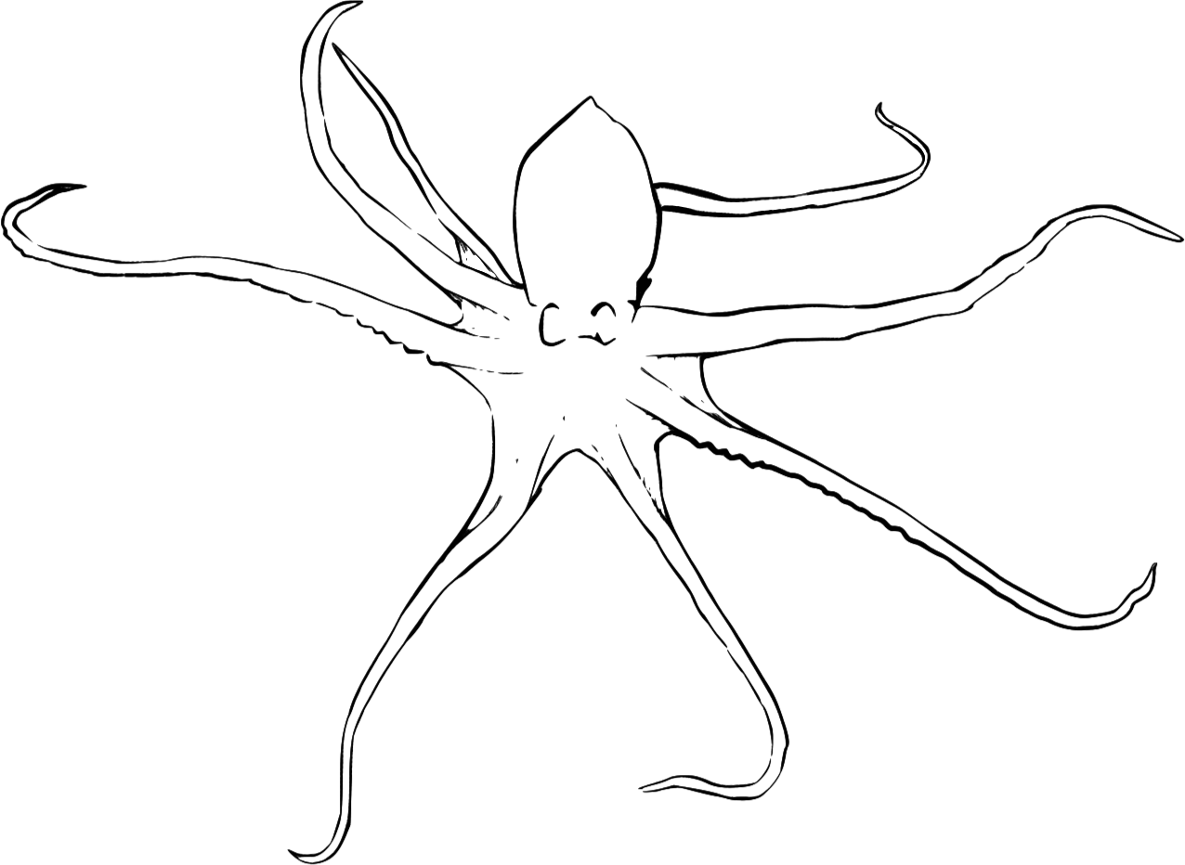
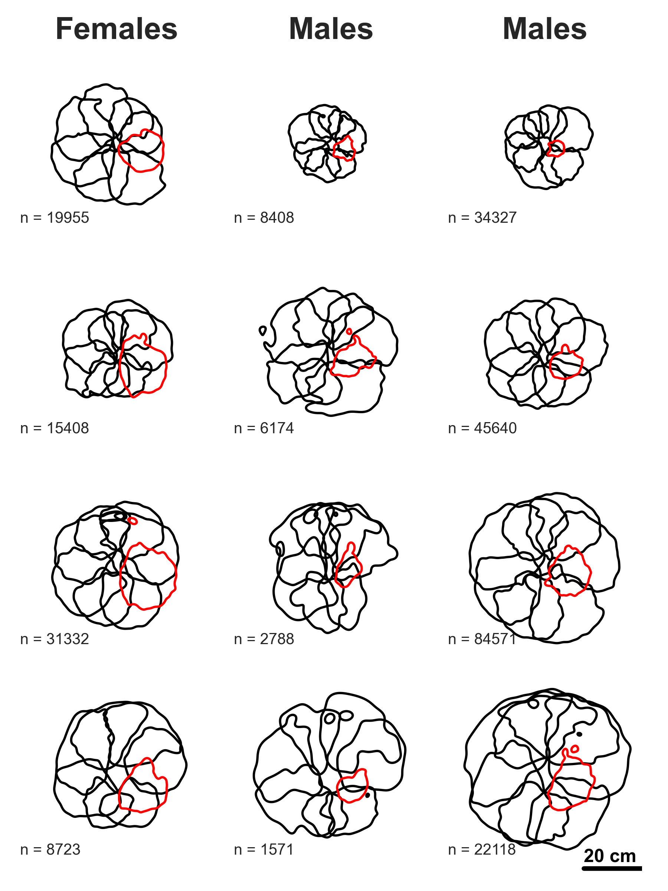
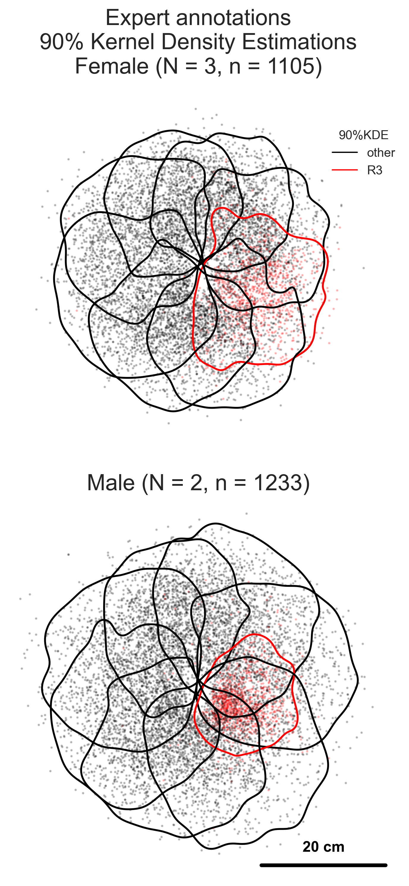
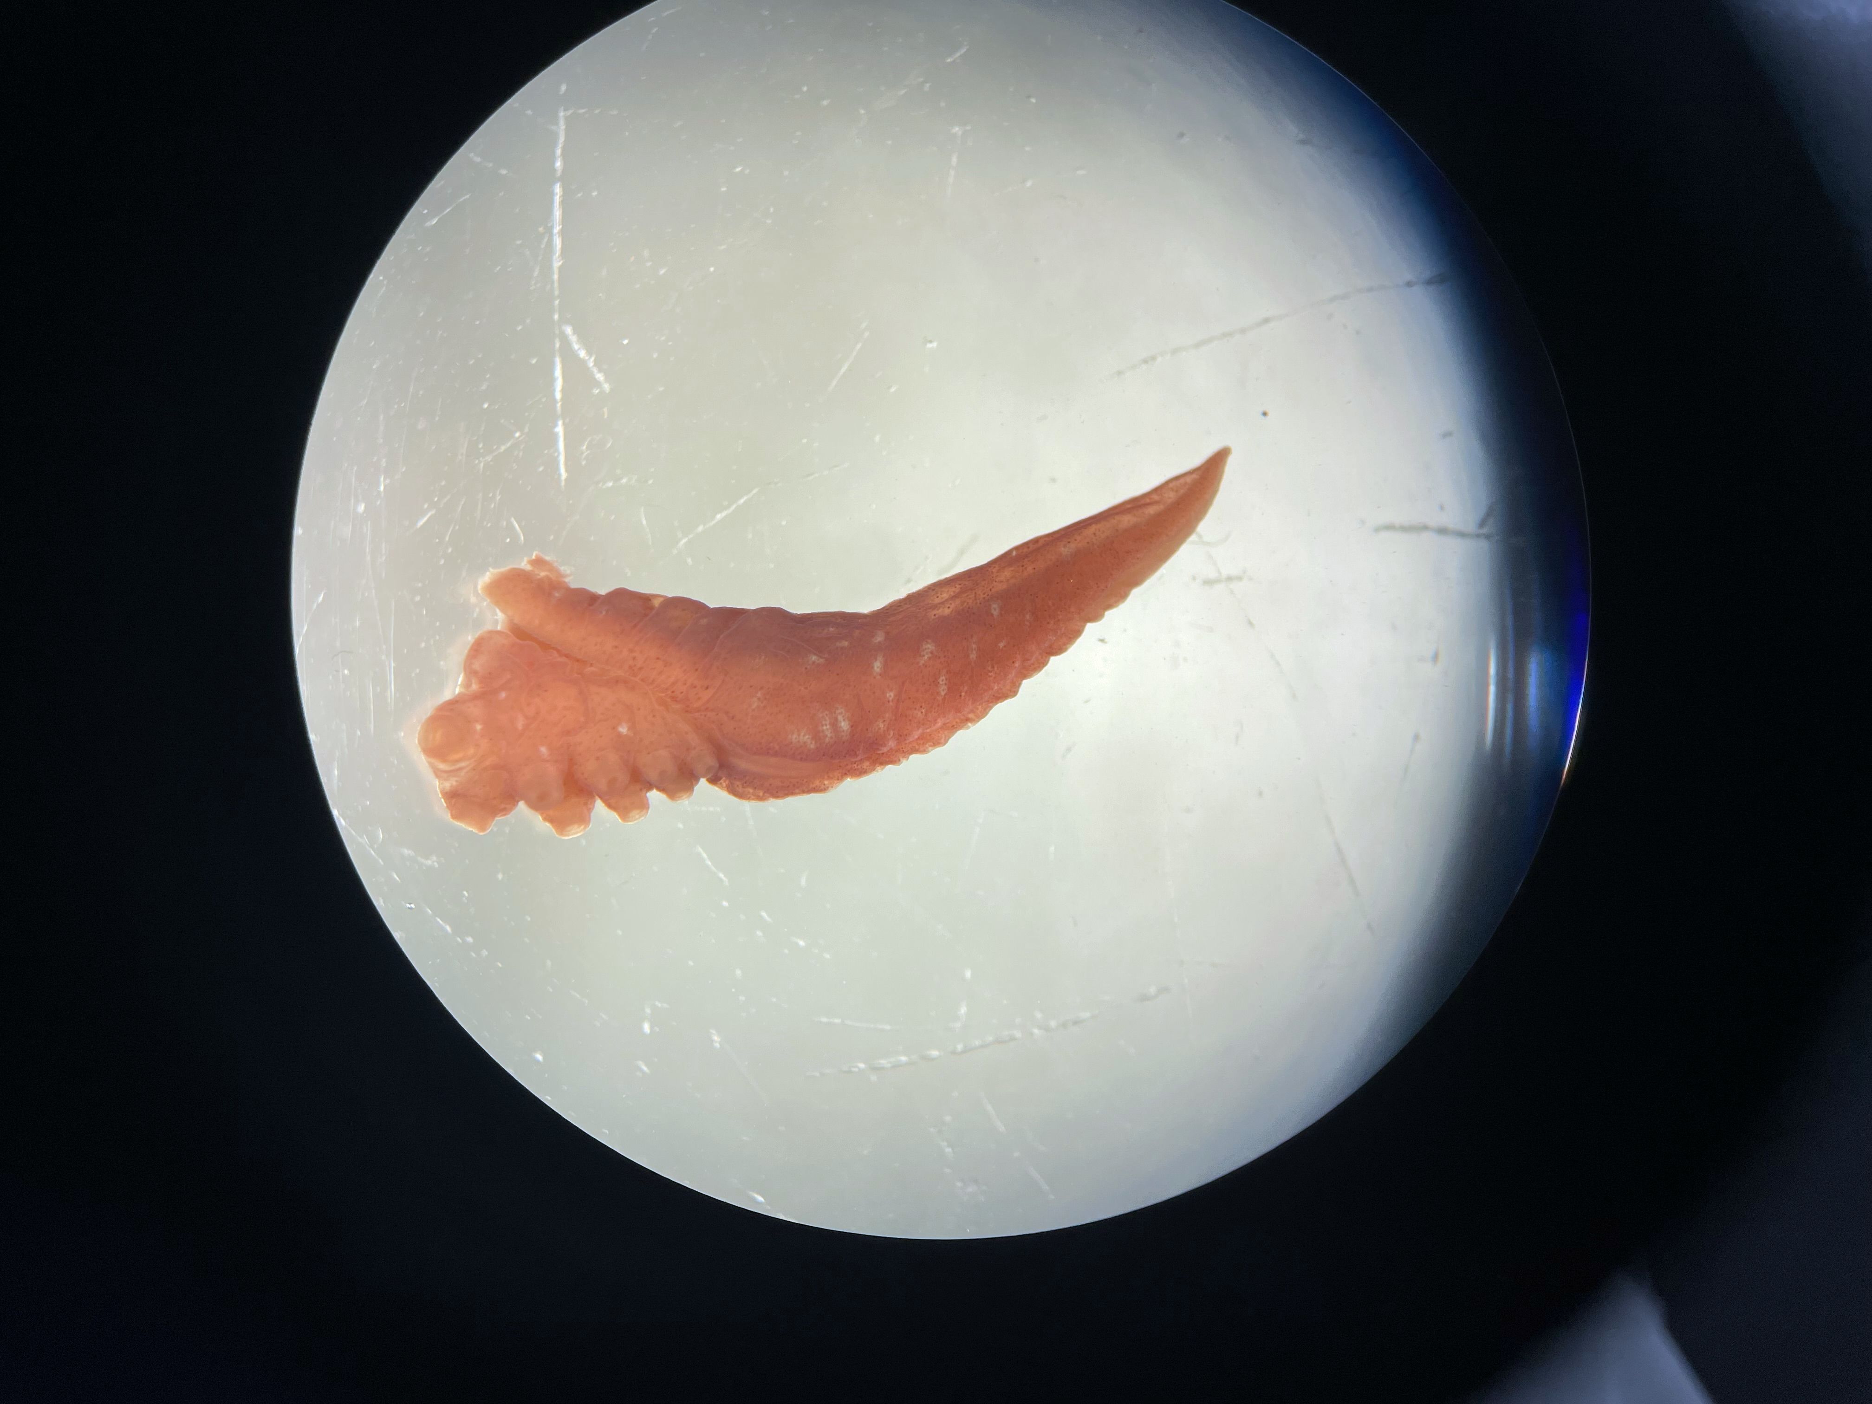
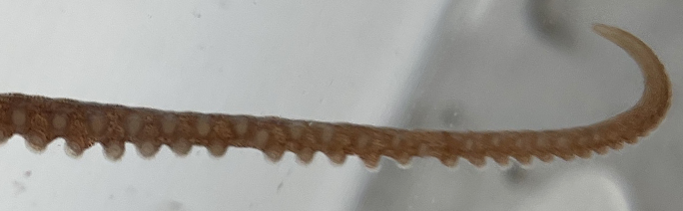
a
R4
d
e
L4
L3
R3
Hectocotylus
L2
L1
R2
R1
b
c
Figure 1. Male octopus hold their hectocotylus closer to their body than other arms. Visual comparison of the third to the right arm tip area distributions of male and female octopus while octopus moved across the center of the aquaria. (a.) A male octopus viewed from above in the behavior recording aquarium. Standard naming convention for octopus arms is used, right arms R1-4 and left arms L1-4 are shown. The hectocotylus is highlighted in yellow. (b.) Dissected and fixed Octopus rubescens hectocotylus showing the arm tip specialization for reproduction. (c.) Unspecialized O. rubescens arm tip. (d. & e.) All annotations were rotated into the octopus frame of reference and oriented perpendicular to the left and right eye axis. Sample size (n) for each sex is the number of annotated images (see Methods for details); sample size (N) is the number of individuals of each sex for which data was annotated to train the model. The third to the right arm (R3) is shown in red. (d.) The combined 90% kernel density estimation (90%KDE) contour of arm tips in the expert annotated training set for DeepLabCut. (e.) The individual 90%KDE for of arm tips for each octopus.

Slide 2
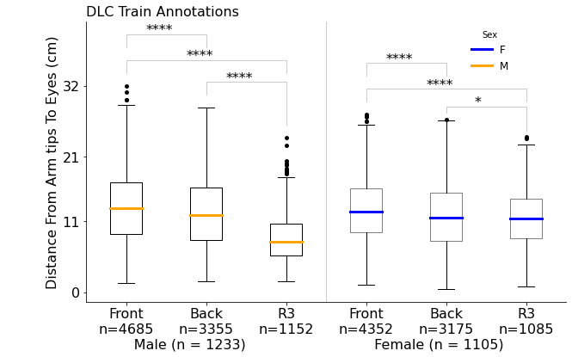
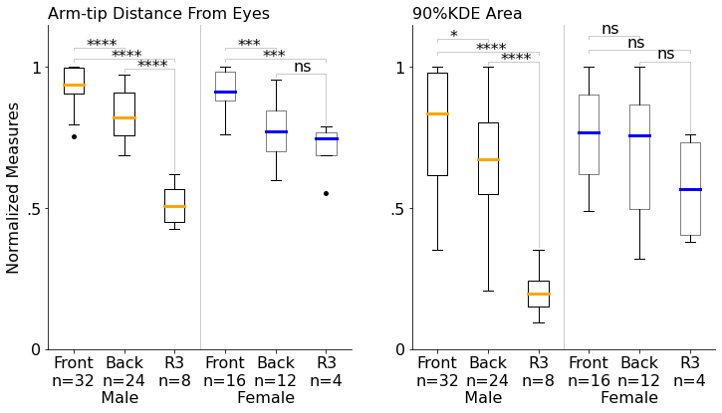
a
b
Figure 2. Octopus display specialization when comparing arm tip distance and areas between the front, back, and third to the right arm. (a.) Compares distance from arm tip to eyes in unnormalized expert labeled images. Sample size (n) for sex is the number of annotated images, sample size (n) for front, back, or R3 is the number of annotated arm tips. Male front arm tips (Front; L2, L1, R1, R2) were closer to their eyes on average than rear arm tips (Back; L3, L4, R4) excluding R3, which was even closer to their body on average than their other rear arms. A similar trend was observed between female Front and Back arms, while the female R3 differed much less in distance to the eyes than males. This small difference was nonetheless significant different because the R3 measurements were taken from a single arm and had a tighter distribution than the combined values in Back. (b.) Normalized arm tip to eyes distance (left panel) and 90%KDE areas occupied by arm tips (right panel) from estimated data (see Methods for details and averaged by individual for each arm tip (sample size (n) ). By individual averages were compared to offset the issue of large sample sizes when using pose estimation annotations. Normalization of measures was used because of the significant distribution of individual sizes in the experiment, see Figure 1e.

Slide 3
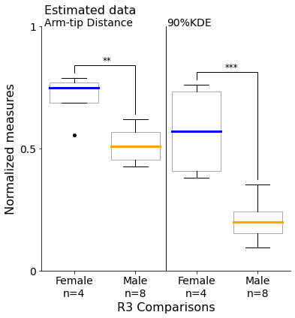
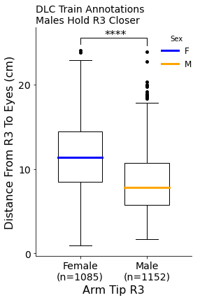
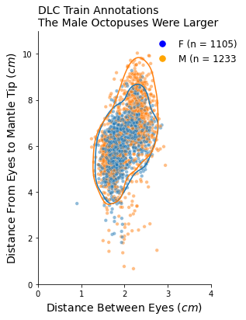
a
b
c
Figure 3. Male octopuses hold their third to the right arm closer to their body and over a smaller area than female octopuses. (a.) Individual averages of normalized distance from third to the right arm tip (R3) to their eyes and the arm tip 90%KDE area. Sample sizes (n) are the number of individuals of each sex compared. (b.) Size differences between sexes of the sampled octopuses (female=3, male=2) in the annotated data (sample size (n) is the number of images annotated). Eye to eye (interocular distance) and eye to mantle tip (mantle length) are common metrics for reporting octopuses size. Lines indicate 90%KDE areas. The male and female octopus size distributions overlap, but the males were a little larger. (c.) Compares the distance of R3 arm tip to the eyes in unnormalized annotated data. Despite the male octopus being slightly larger than the females, the male octopus held R3 closer to their eyes than females.

Slide 4
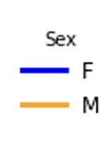
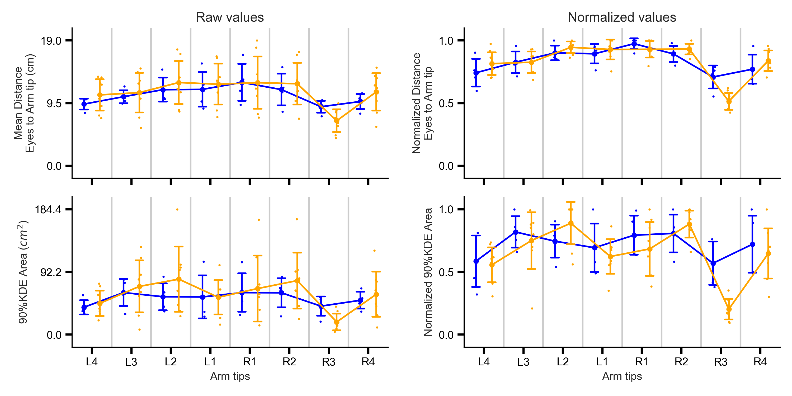
a
b
Figure 4. Raw (a. left) and normalized (b. right) arm tip distances (top) and 90%KDE (bottom) averaged by individuals show differences between sexes and body axes. All plots use DeepLabCut estimated data. Sample size (n) is the number of female and males compared (Females = 4, Males = 8). The effects of normalization are especially apparent in comparing raw arm tip distances, with smaller interquartile ranges, and greater separation between R3 and the other arms after normalization.

Slide 5
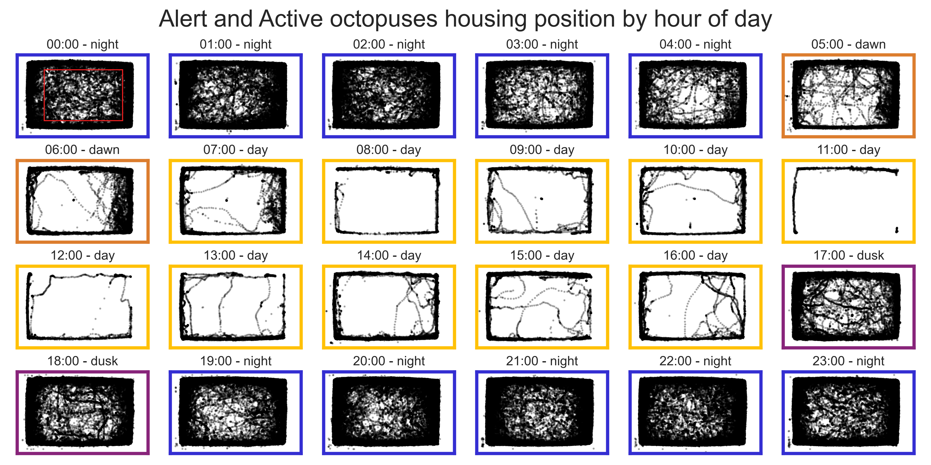
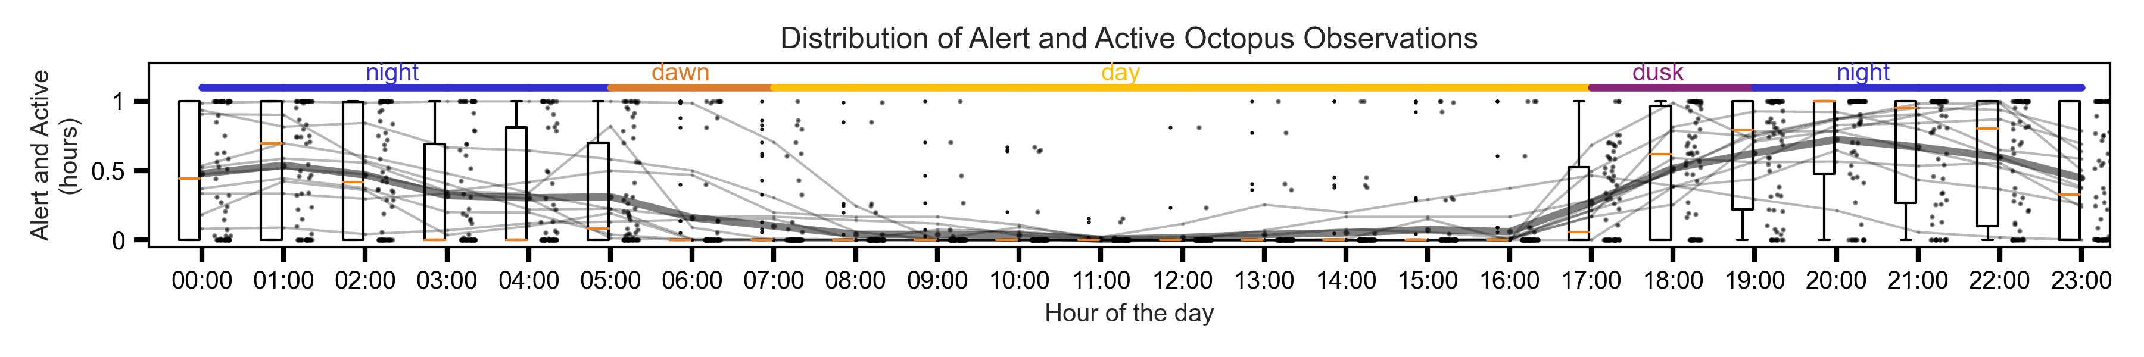
a
b
Figure 5. Octopus rubescens in captivity showed nocturnal patterns of activity. Locations of 10 different alert and active octopuses, held at different times, continuously recorded within the aquaria for a total of 66.9 days of observations. A pair of experimenters exhaustively annotated when the octopus were visibly alert and active or not in the video footage. The large aquaria and relatively low-resolution video footage made pupil dilation unobservable, consequently octopus stationary for long periods regardless of quiescent state were annotated as not alert and active. (b.) Raw unfiltered DeepLabCut mean eye locations of alert and active octopus within the aquaria split by hour of day. The red rectangle within the top left subplot indicates in boundaries of the out in the open region of the aquaria for which arm tip were used for this study. The aquaria had an automated slow on slow off lighting system with hour long dawns and dusk. Bright near infrared lamps were the primary means of illumination of the octopus at all times of day. During the simulated day, the octopus very rarely went into the middle of the aquaria where their arms could be recorded in a geometrically unbiased manner. The octopus were fed after dusk as part of another complimentary experiment on odor plume guided search by octopuses which involved feeding them at night under infrared lights. (c.) Compares time the octopuses spent active and alert by hour of the day. Each hour of the day has on the left a boxplot of observations, on the right a jittered scatter plot, and the traces of each octopus average shown in a faint gray line, and the average of all the octopuses shown as a dark gray trace.

